Slide 1
Property Inspection Demo
Preparation and Walkthrough

Slide 2
Preparing Calendars
Log into OWA with Ron Gabel and delete all calendar events for the day after the demo. For example, if you are doing the demo on the October 28 then delete all entries on the October 29.
This step is done to make the calendar clean so it is easy to see the new calendar invites that are added with the Microsoft Graph API.

Slide 3
Walkthrough
These following slides describe how to execute the demo, the lists items that are modified during each step, and the emails which are sent.

Slide 4
Inspection Walkthrough
The inspector arrives at the property and uses the Inspection mobile app to report inspection findings.

Slide 5
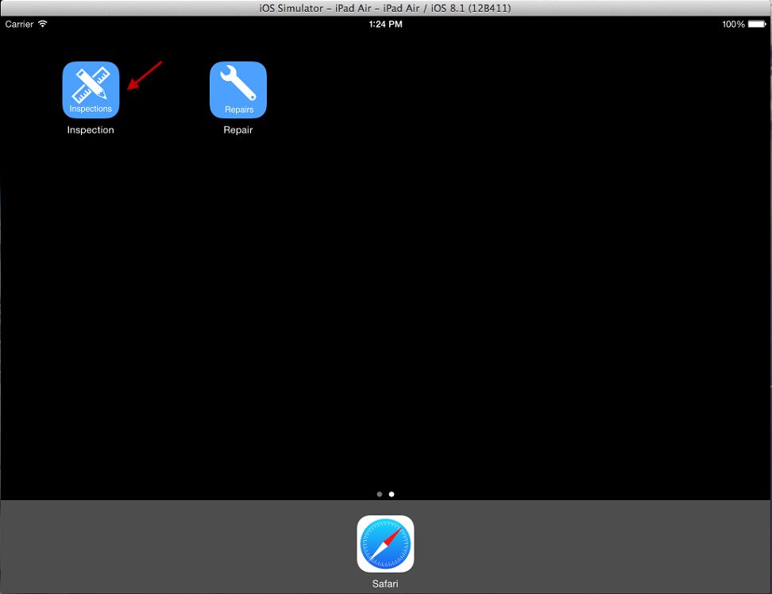
Open Inspection App on device
In this demo script the screenshots for the mobile devices were taken in the iOS simulator.
The steps are identical in the iOS, Android, Cordova, and Xamarin mobile apps.

Slide 6
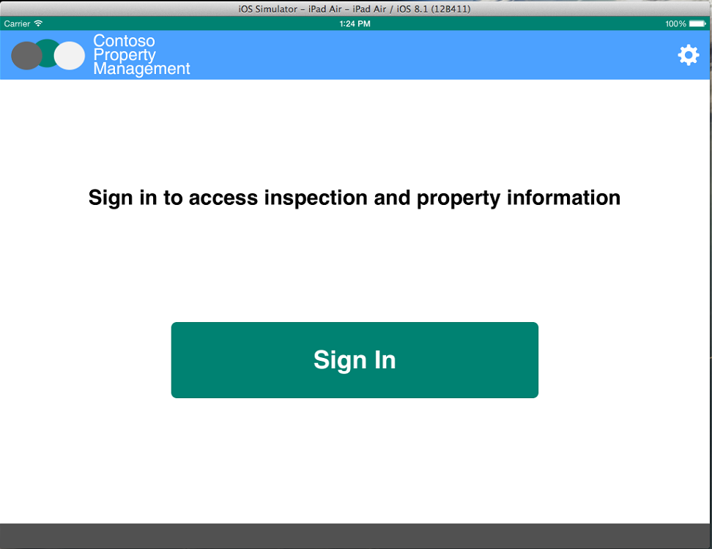
Click Sign In

Slide 7
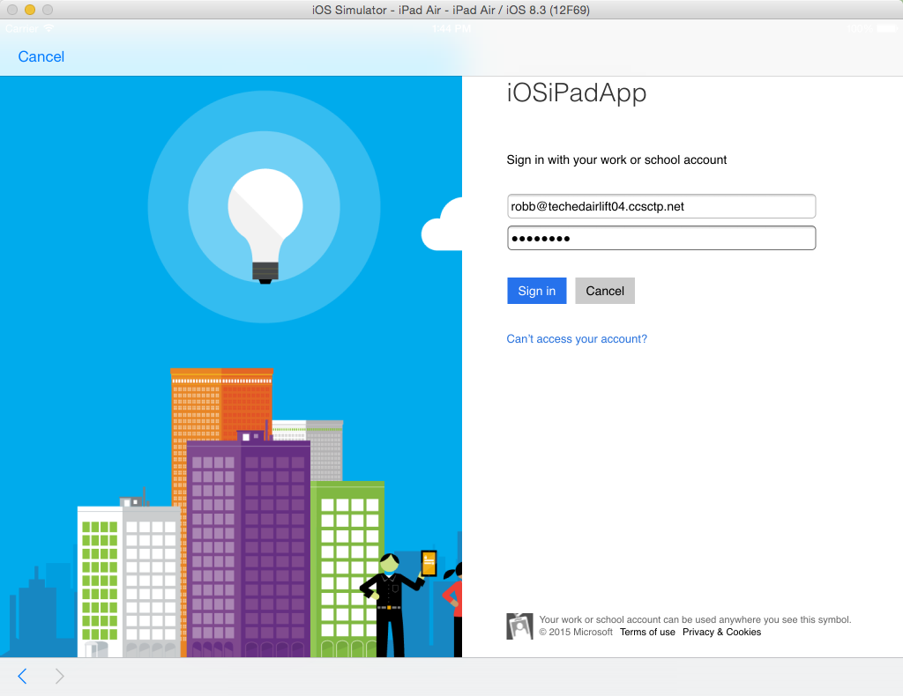
Enter inspector credentials Username: robb@<tenancy>.onmicrosoft.com Password: TempP@ssw0rd! (default) Do not check Keep Me Signed In Click Sign In If you have not already signed in with this user you will be prompted to reset the user’s password.

Slide 8
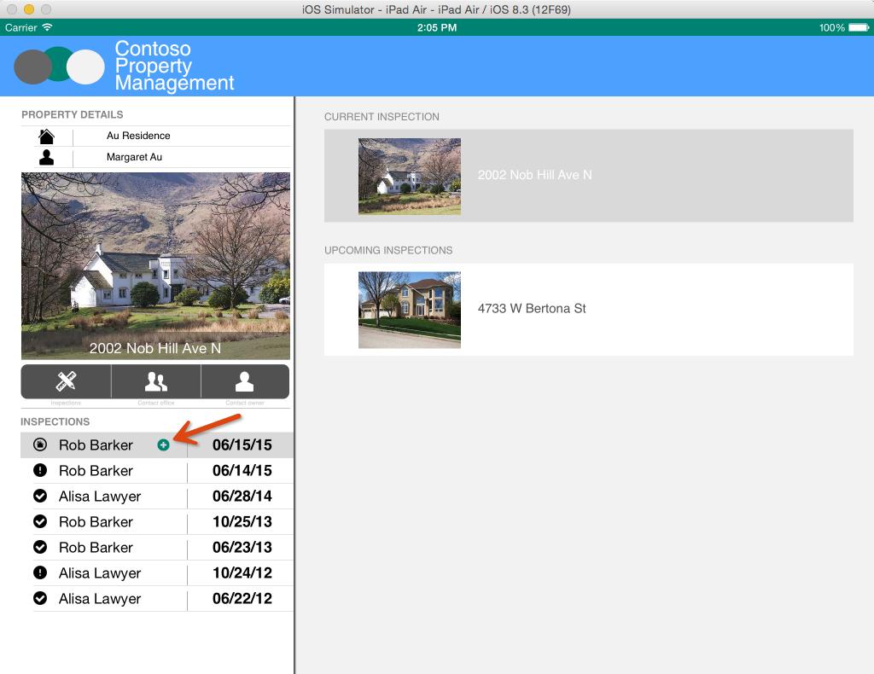
Click the inspection with the plus icon

Slide 9
Submitting an inspection comment
Inspection comments are informational, they do not require action or indicate anything is wrong.

Slide 10
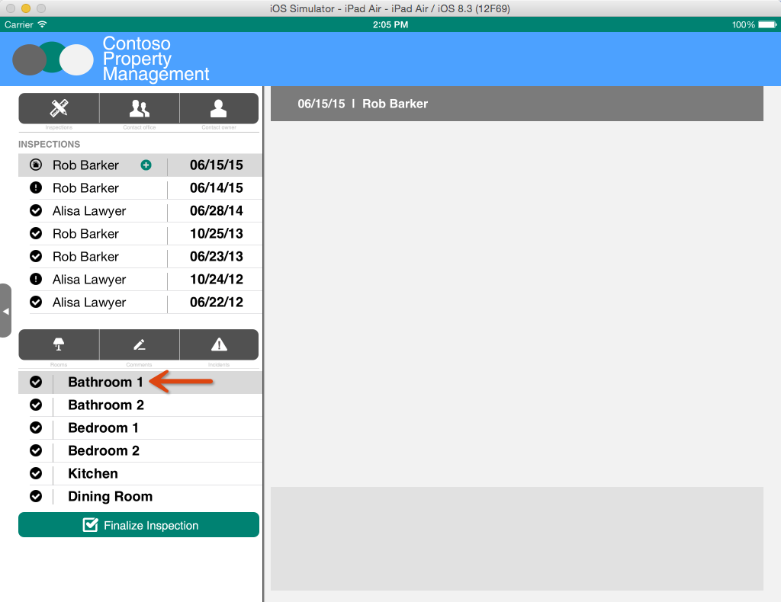
Select Bathroom 1

Slide 11

Click Comments

Slide 12
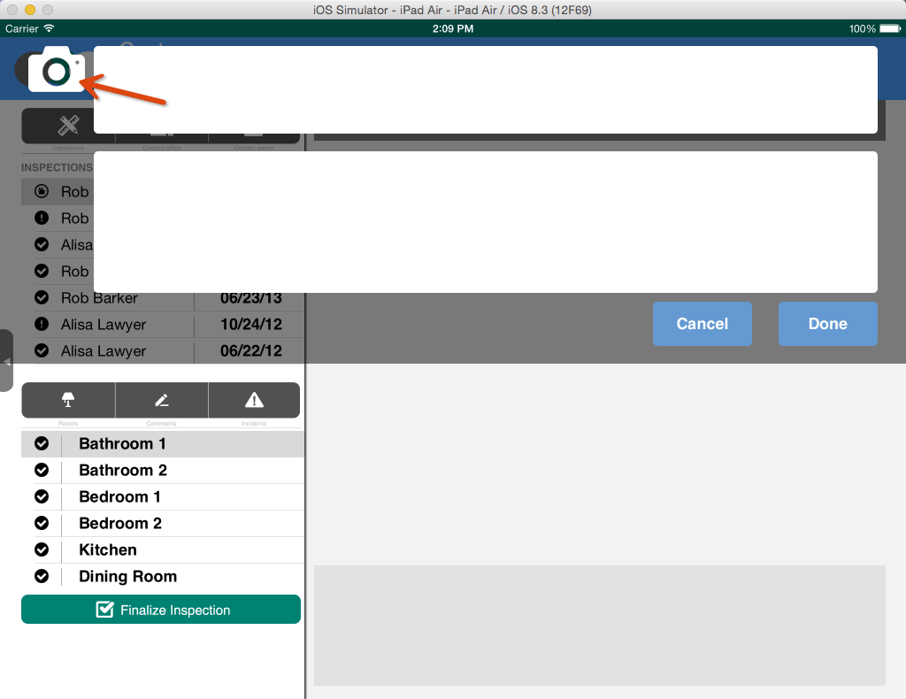
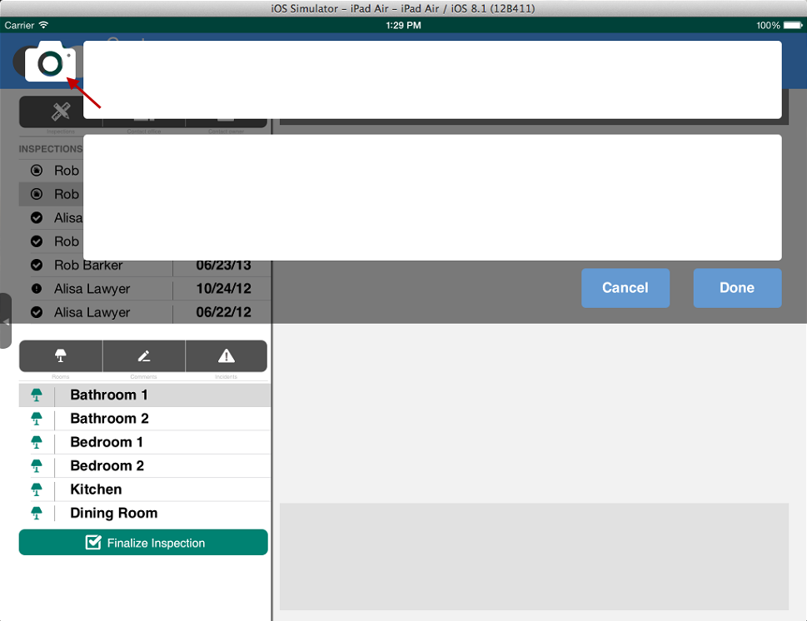
Click Camera

Slide 13
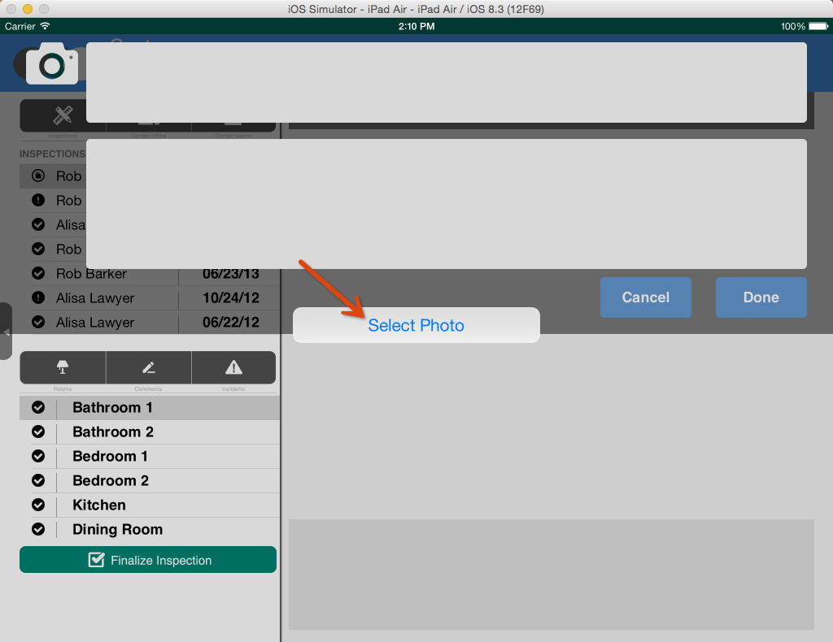
Select photo or take picture
If you are running on a physical device you will be able to use the device’s camera to take a photo.
If you are running in the simulator you will be able to take a photo with your computer’s web cam if you have your simulator configured to use the web cam.
If you do not have a camera configured you will be able to select a photo.

Slide 14
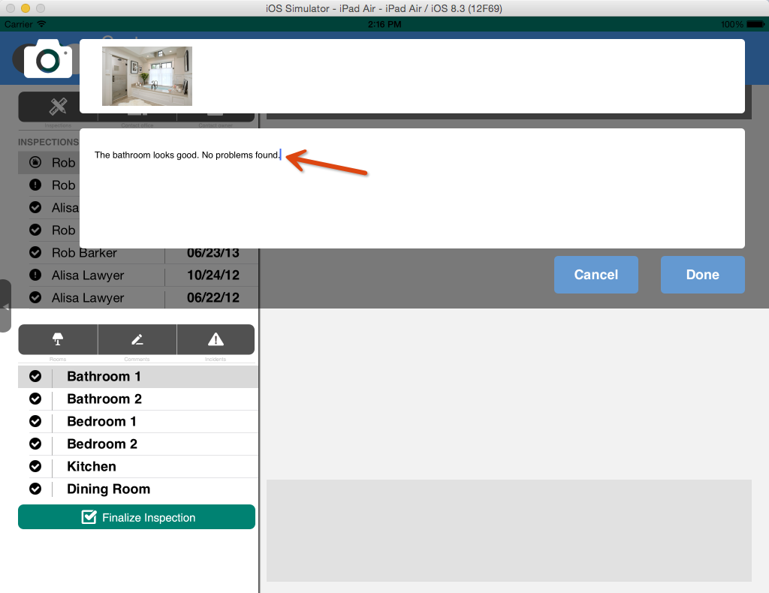
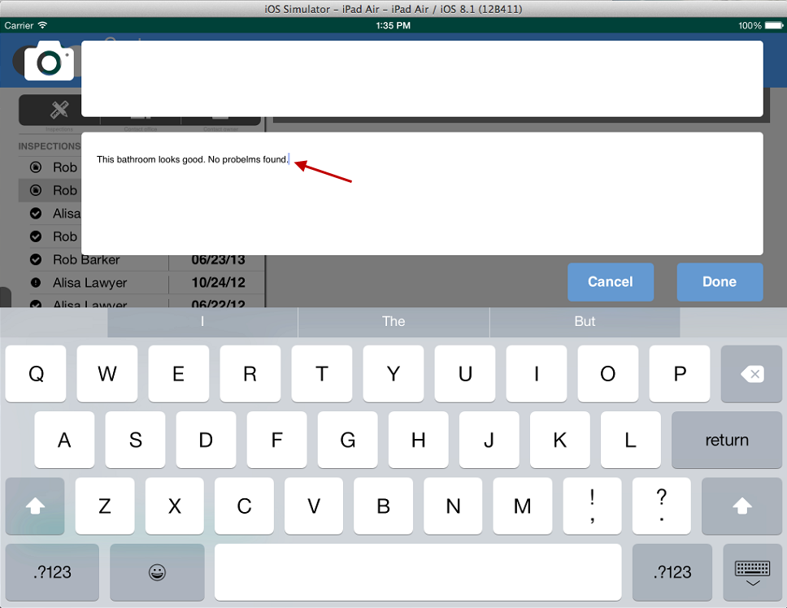
Enter Comments

Slide 15
Click Done
Picture is uploaded to Room Inspection Photos Document Library
Inspection comment is created in Inspection Comments List

Slide 16
Submitting an incident
Incidents indicate there is a problem that needs to be repaired.

Slide 17
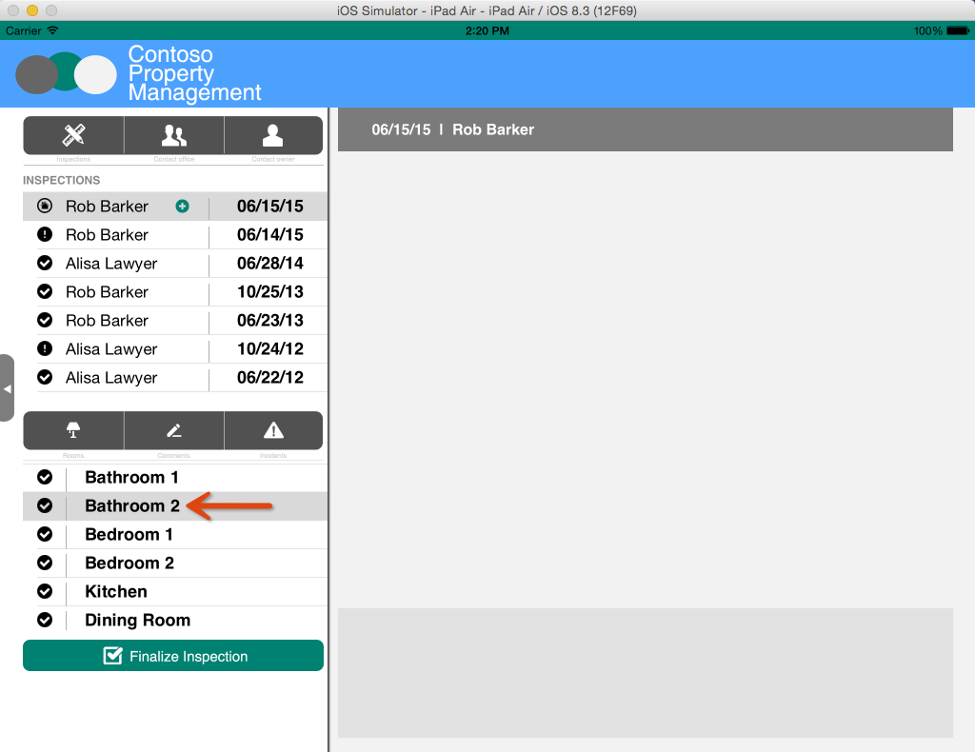
Select Bathroom 2

Slide 18
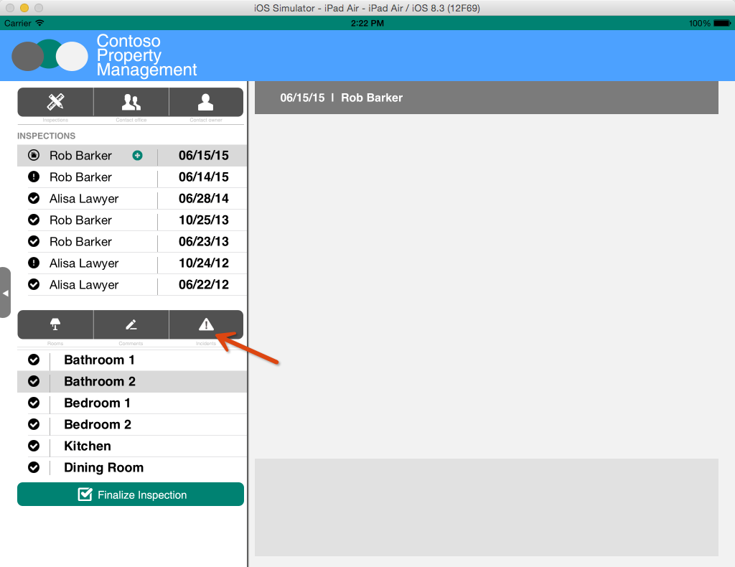
Click Incidents

Slide 19
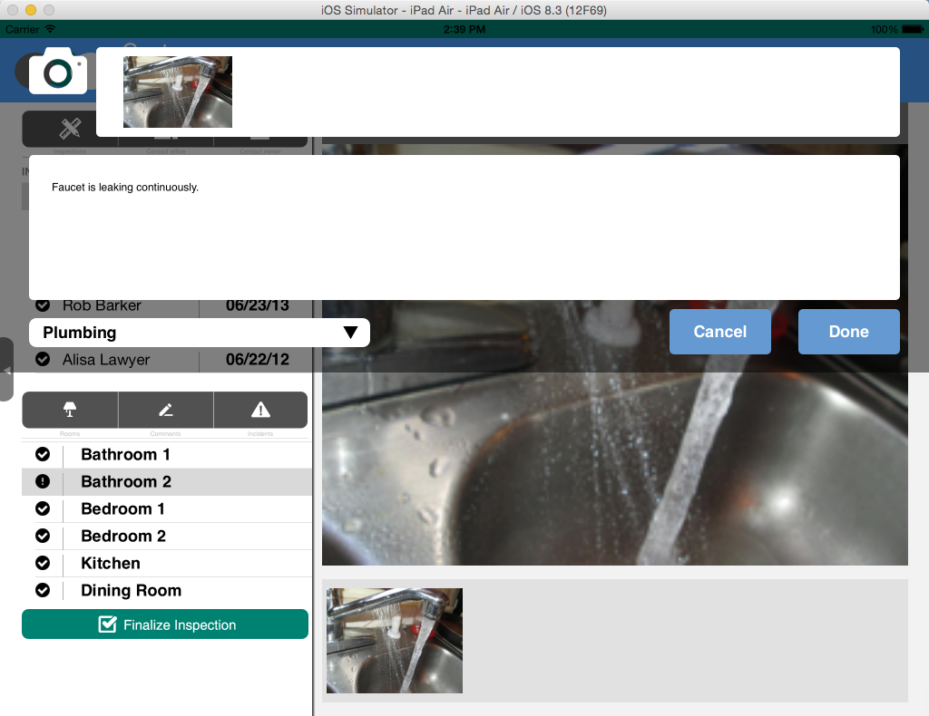
Just like you did in the Inspection Comments popup, take a picture and enter comments. Then, select an Incident Type and click Done.
Incident is created in Incidents List
Photo is added to Room Inspection Photos Document Library
Workflow Task is created for Dispatcher

Slide 20
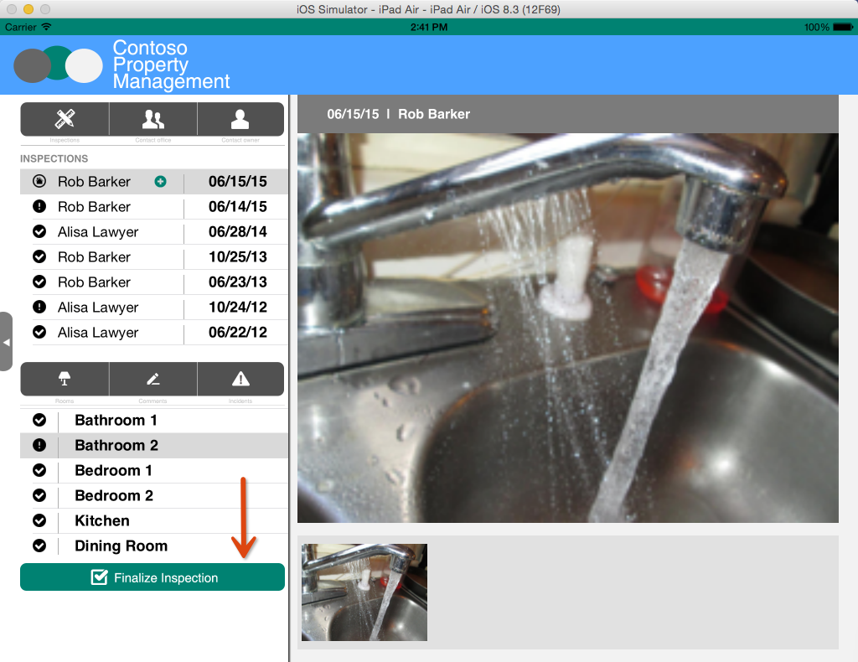
Click Finalize Inspection

Slide 21
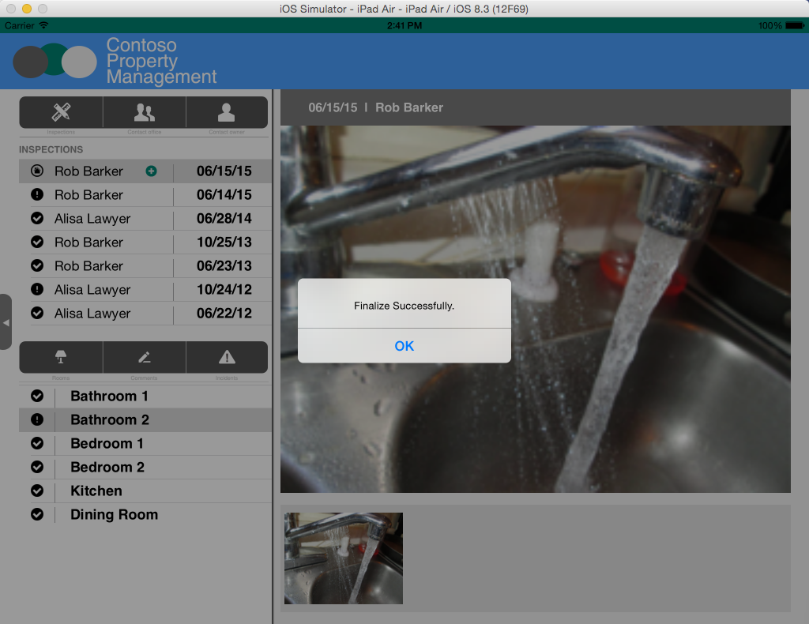
Get Confirmation
Inspection in Inspections List is updated with Finalized Date

Slide 22
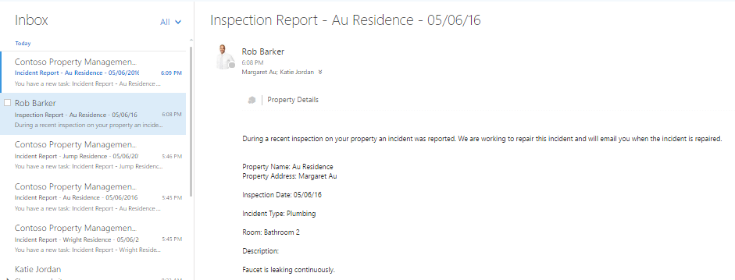
Inspection report email is sent to property owner and dispatcher Log in with Dispatcher account to see the email Username: katiej@<tenancy>.onmicrosoft.com Password: TempP@ssw0rd!

Slide 23
Dispatcher Scheduling Walkthrough
The dispatcher reviews the incident found at the property and schedules a repair.

Slide 24
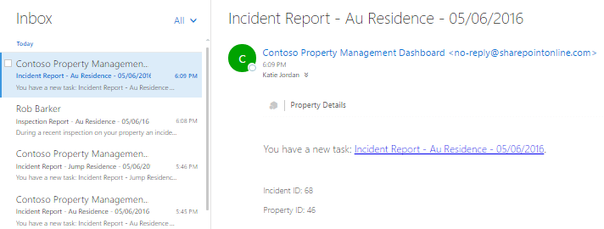
Incident Report email is sent to dispatcher Log in with Dispatcher account to see the email Username: katiej@<tenancy>.onmicrosoft.com Password: TempP@ssw0rd!

Slide 25
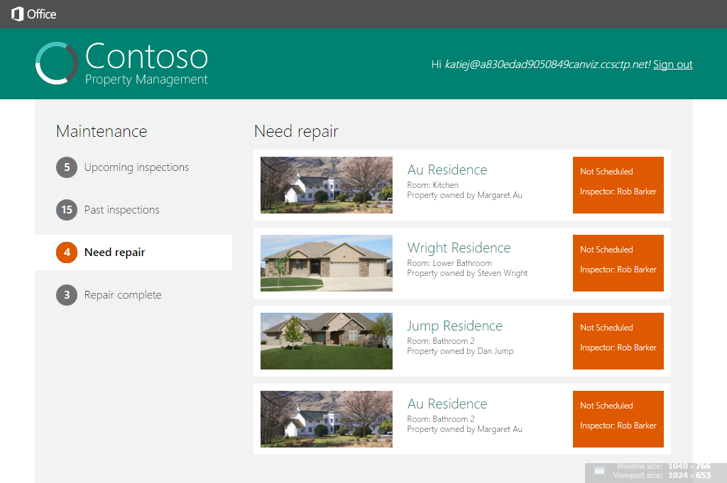
Open the Property Management Web App Dashboard and click Need Repair

Slide 26
Click Not Scheduled

Slide 27
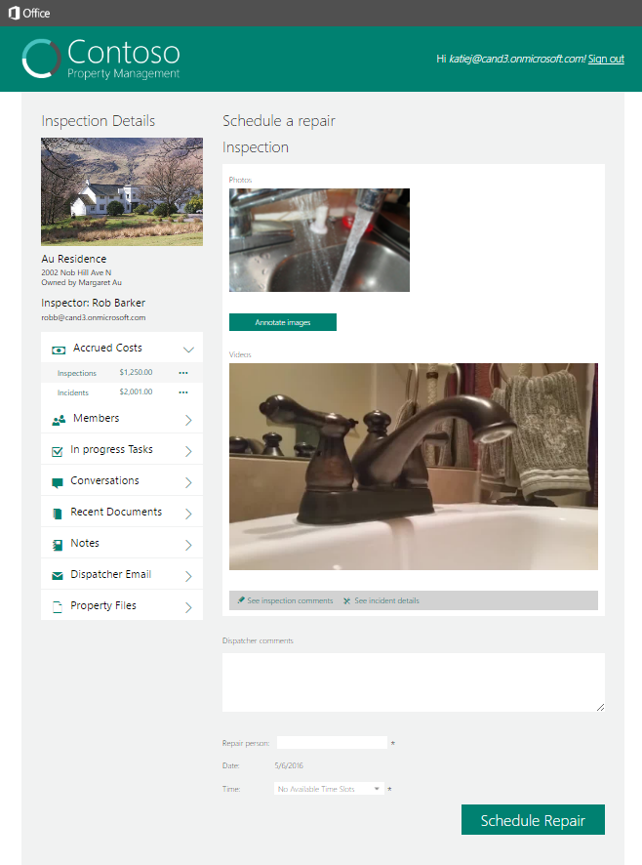
View the Accrued Costs associated with the Office 365 Group corresponding to this property.
Accrued Costs

Slide 28
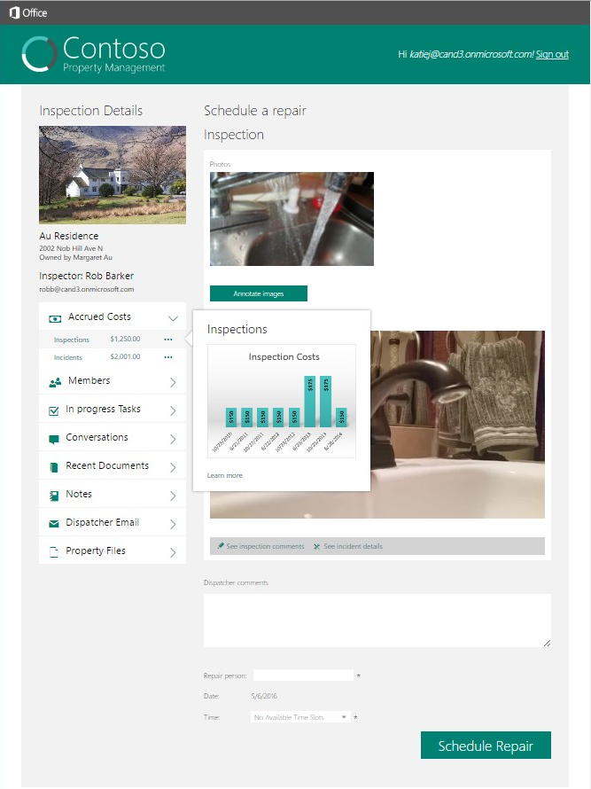
Click the ellipse button and look at the fly out with the thumbnail picture of the file. Click the ellipse button again to close the fly out box.
Click eclipse button

Slide 29
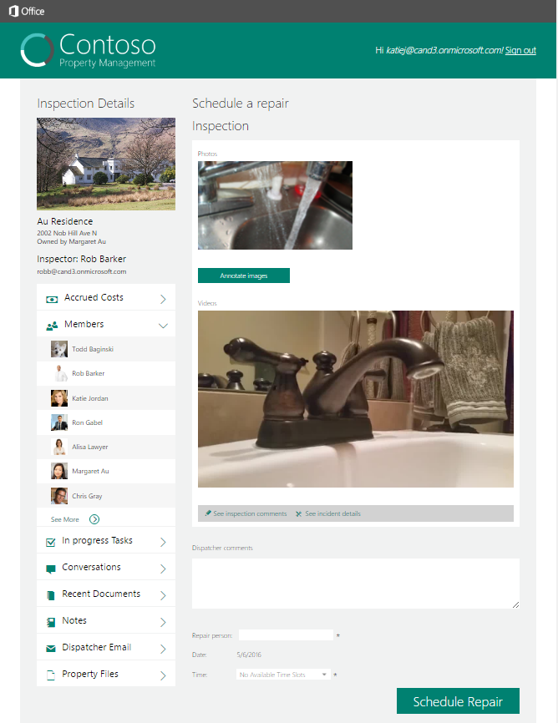
View the members associated with the Office 365 Group corresponding to this property.
Members

Slide 30
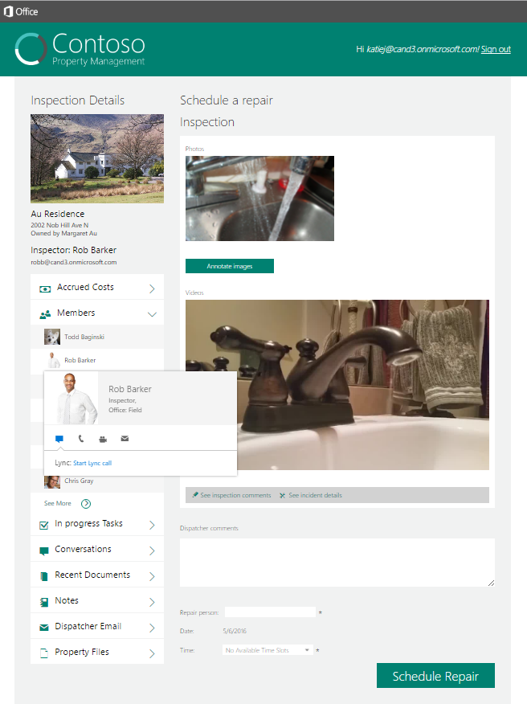
Click a member to view user profile at the persona card fly out. Click the member again to close the persona card fly out.
Click Ron Gabel

Slide 31
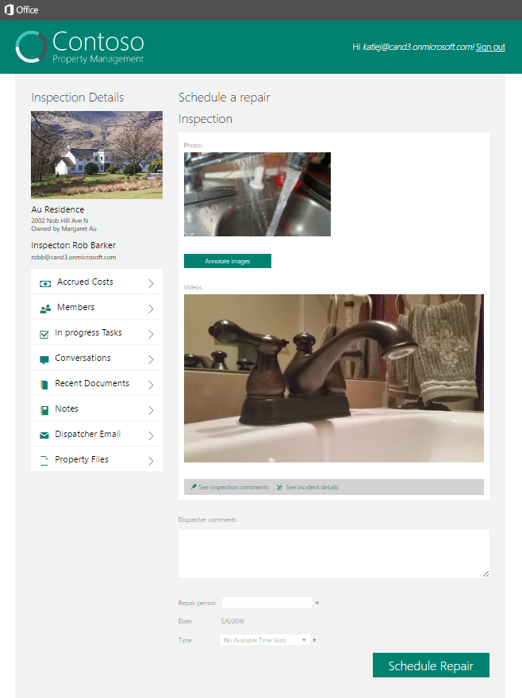
View the videos associated with the incident. Click one of the videos in the page and a new browser window opens to view the video.
Videos

Slide 32

View the conversations associated with the Office 365 Group corresponding to this property. Click one of the conversations in the list and a new browser window opens to view the conversation.
Conversations

Slide 33
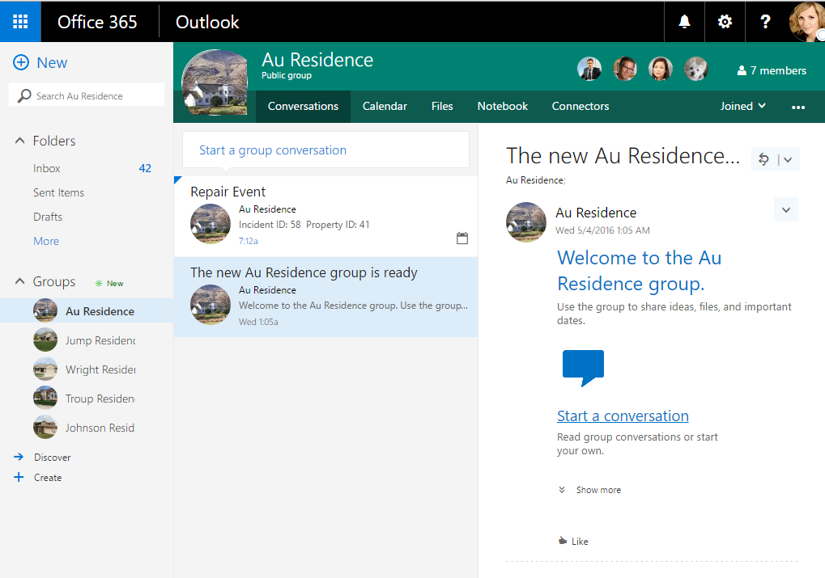
View the conversation in a new web browser.

Slide 34
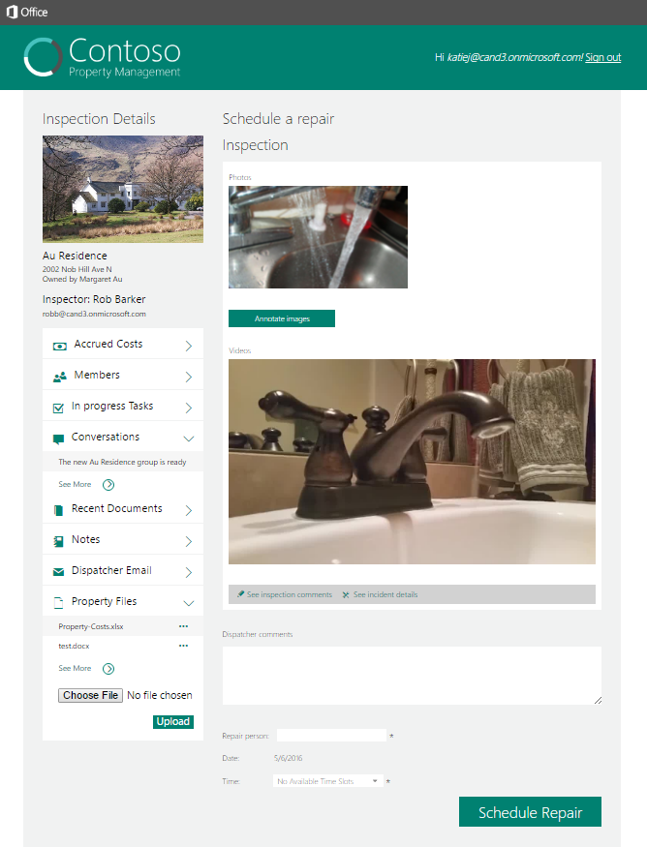
Click the Choose File button and select a file on your computer. Click the Upload button to upload a document to the Files library in the Office 365 Group corresponding to this property. The page and list refresh after the file is uploaded.
Click Choose File
Click Upload

Slide 35

View the recent document associated with the Office 365 Group corresponding to this property. Recent documents are documents that have been modified in the last 7 days. Click one of the documents in the list and a new browser window opens to view the document.
Recent documents

Slide 36
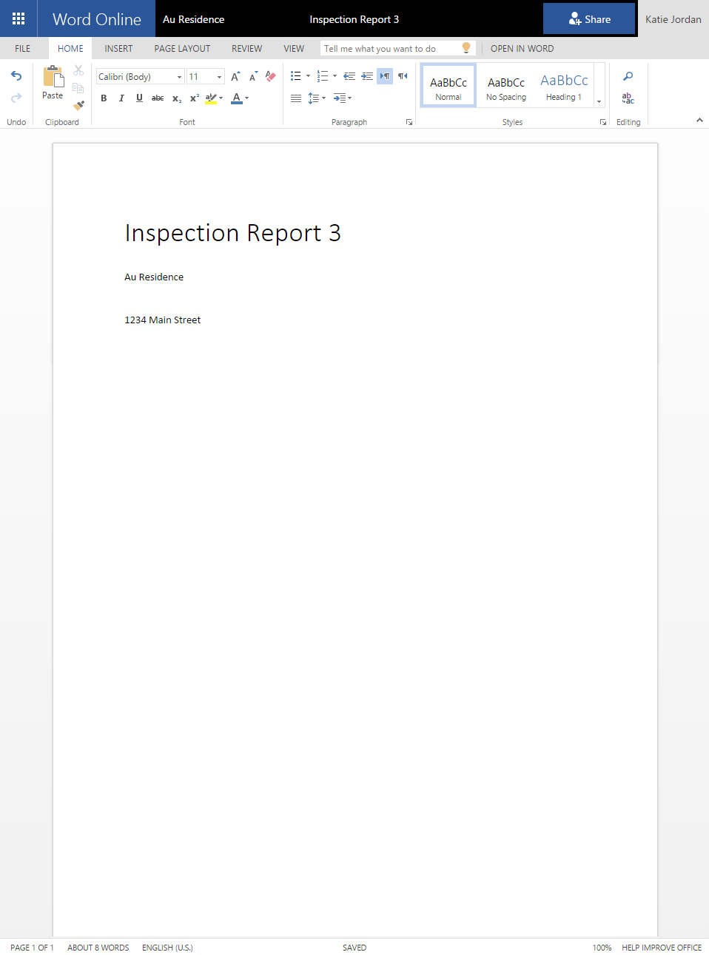
View the document in a new web browser.

Slide 37
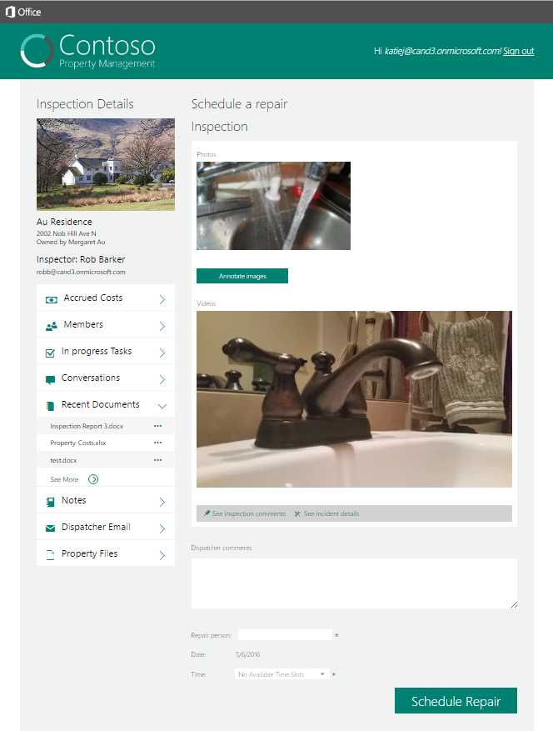
View the documents associated with the Files library in the Office 365 Group corresponding to this property. Click the See more link at the bottom of the list and a new browser window opens to view the documents.
Click the See More link

Slide 38
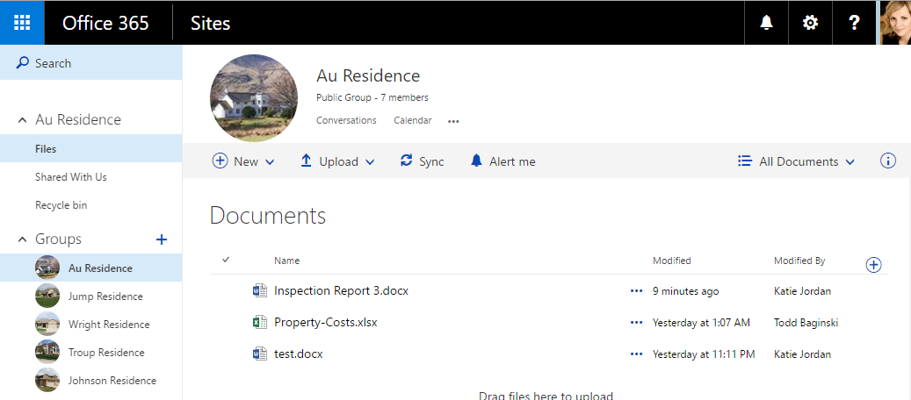
View the documents in a new web browser.

Slide 39
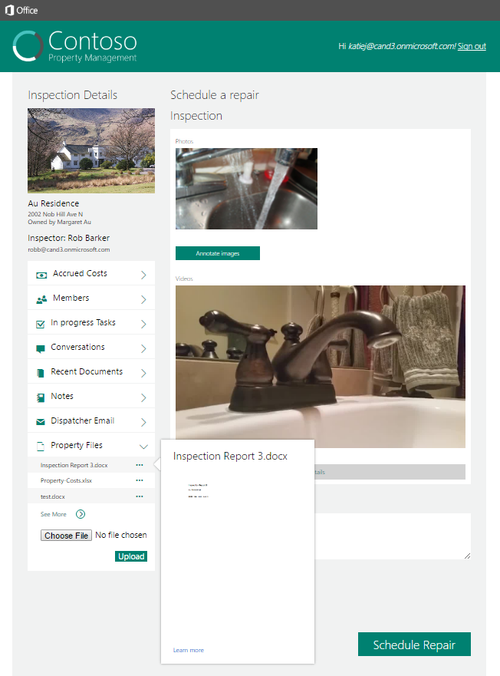
Click the ellipse button and look at the fly out with the thumbnail picture of the file. Click the ellipse button again to close the fly out box.
Click eclipse button

Slide 40

Click the Annotate Images button to create a new page in the OneNote notebook in the Office 365 Group corresponding to this property. Note: If this button is disabled, it means the OneNote service is not completely initialized. It usually takes about 24 - 48 hours for a tenancy.
Click Annotate Images

Slide 41
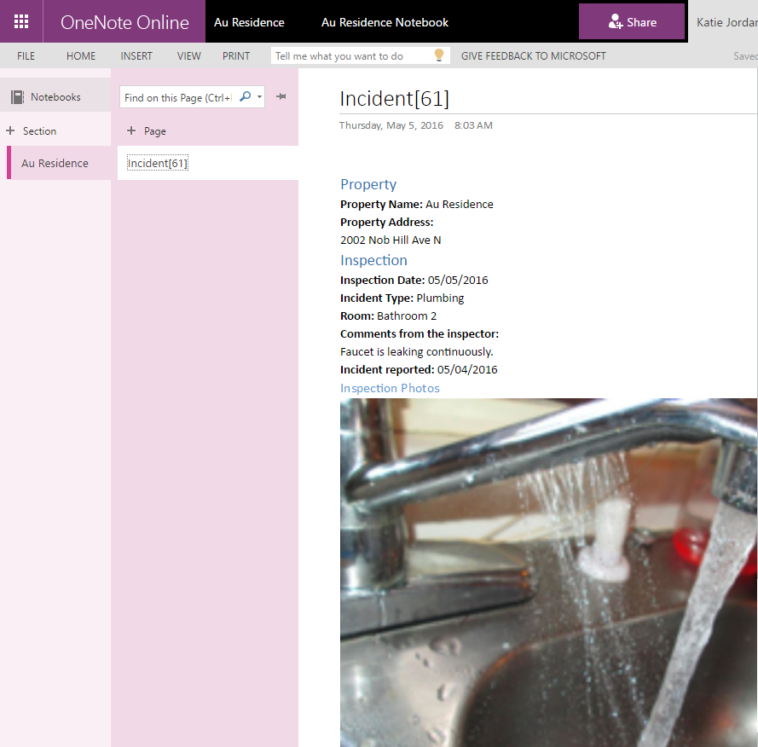
View the new OneNote page in a new web browser and make annotations to the images in it.

Slide 42
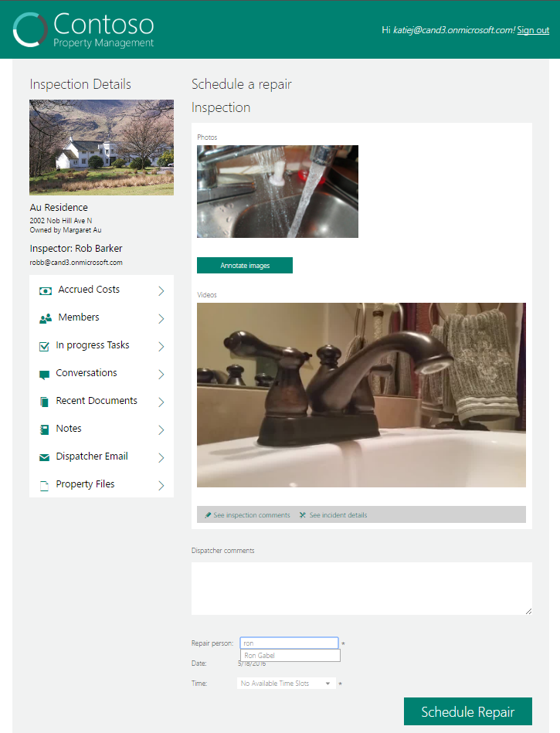
In Repair person field, type ron characters, the result that the Graph People API finds will show.
Type ron characters

Slide 43
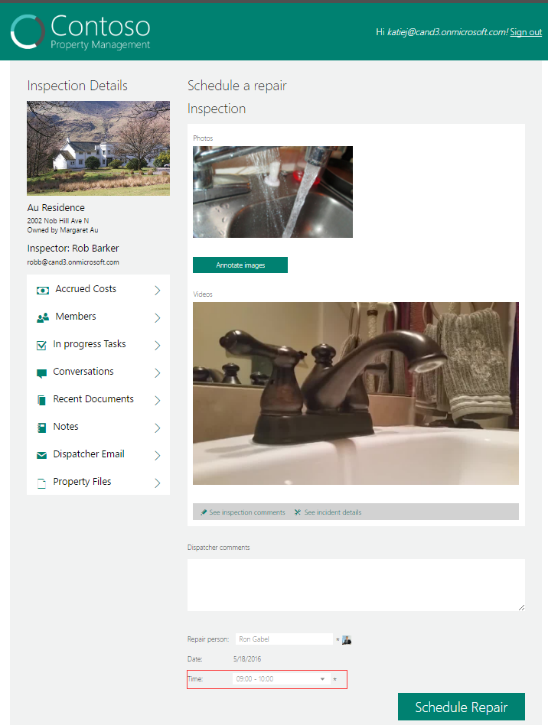
Select Ron Gabel, the person picture will be displayed, and the available time slots result that the Graph findMeetingTimes API finds will show.
Available time is displayed

Slide 44
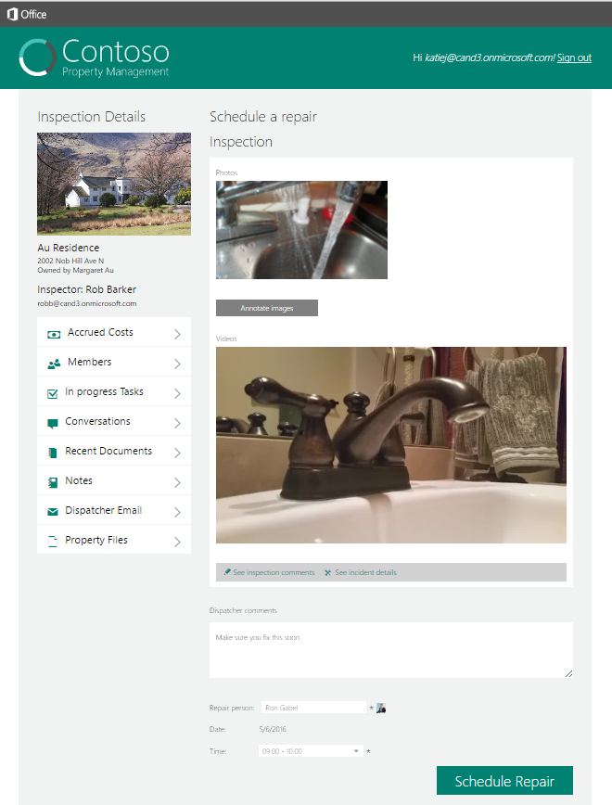
Enter dispatcher comments, type Ron Gabel, select Time, click Schedule Repair
Incident in Incident List is updated to reflect Status, Repair Scheduled Date, and Repair Person assigned
Workflow Task for Dispatcher is completed
Workflow Task for Repair Person is created
A bucket is created in the Plan associated with the Office 365 Group. The bucket corresponds to the incident.
Three tasks are added to the bucket.

Slide 45
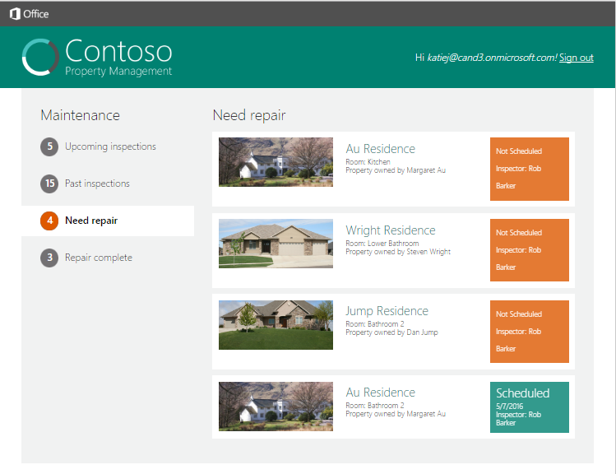
Click Need repair and mention the repair is scheduled. Click this incident.

Slide 46
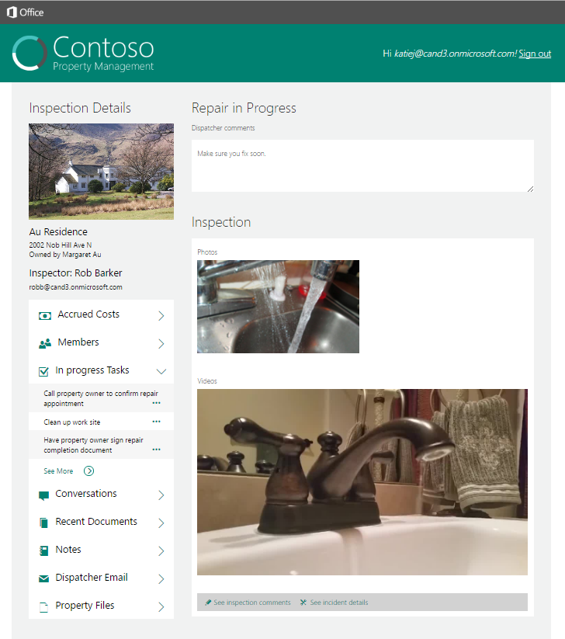
Click the See more link at the bottom of the list and a new browser window opens to view the plan and tasks.
Tasks

Slide 47
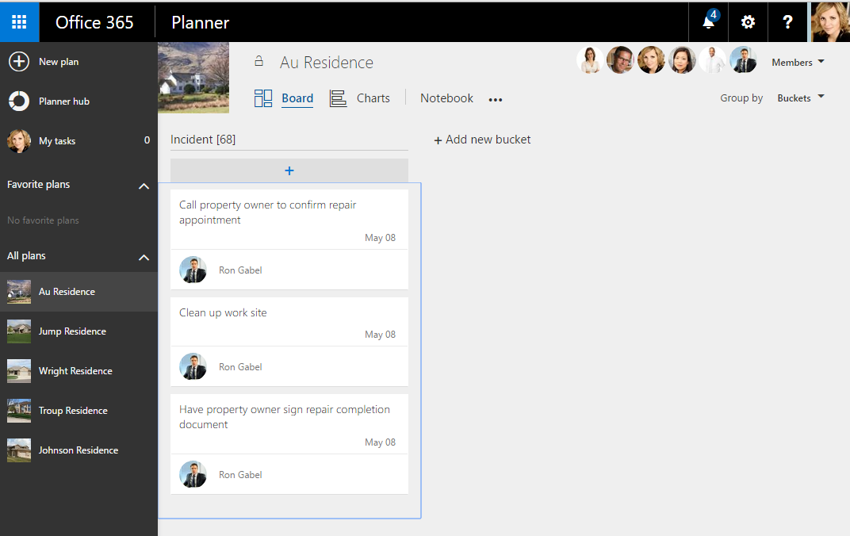
View the plan for the Office 365 Group associated with the property in a new web browser.

Slide 48
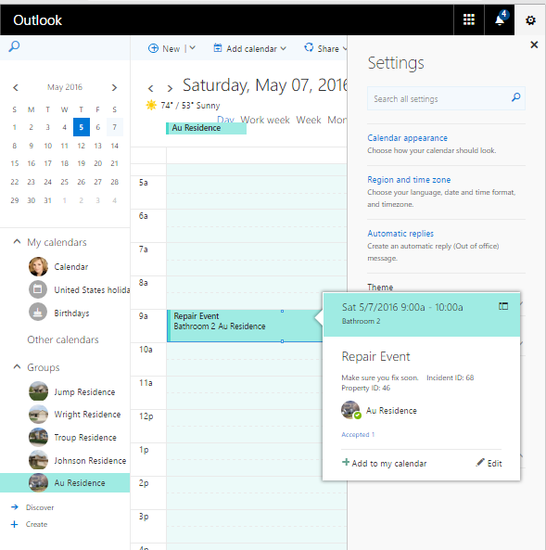
View the shared calendar for the Office 365 Group associated with the property in a new web browser. Click the new event.

Slide 49
Repair Walkthrough
The repair person reviews the incident found at the property, repairs the incident, documents the repairs, and submits the repair for approval.

Slide 50
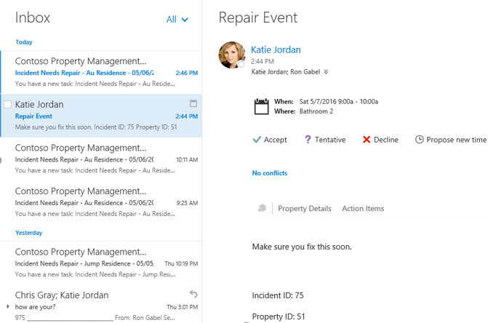
Accept repair event Log in with the Repair Person account to see the email for the repair event Username: rong@<tenancy>.onmicrosoft.com Password: TempP@ssw0rd!

Slide 51
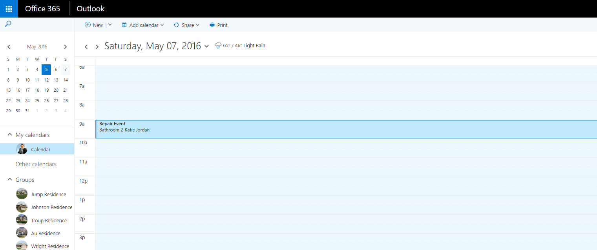
View calendar event and accept it

Slide 52
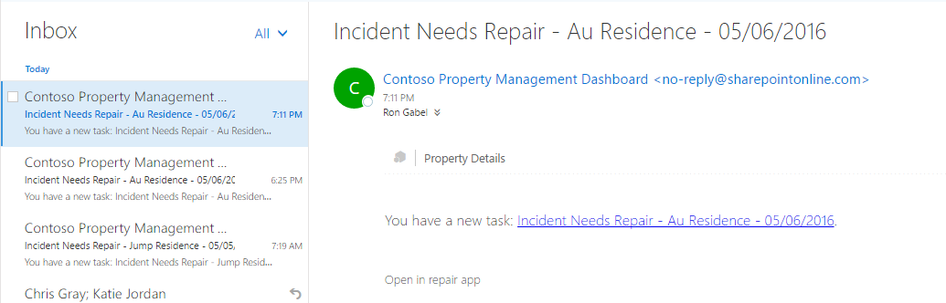
View repair task email sent to Ron Gabel

Slide 53
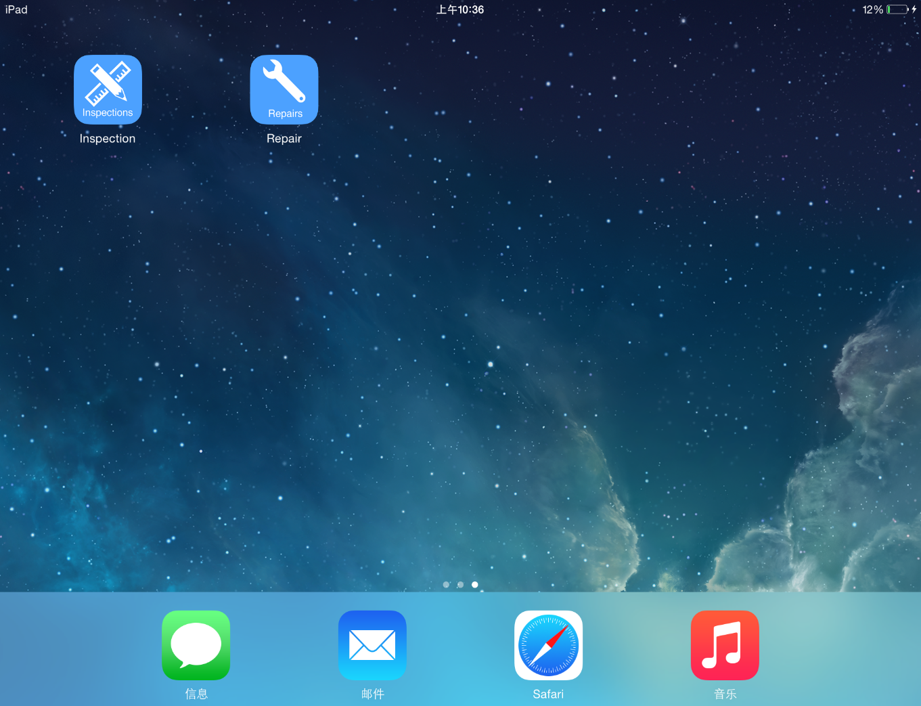
Open Repair App on device
In this demo script the screenshots for the mobile devices were taken in the iOS simulator.
The steps are identical in the iOS, Android, Cordova, Xamarin, and Windows Universal mobile apps.

Slide 54
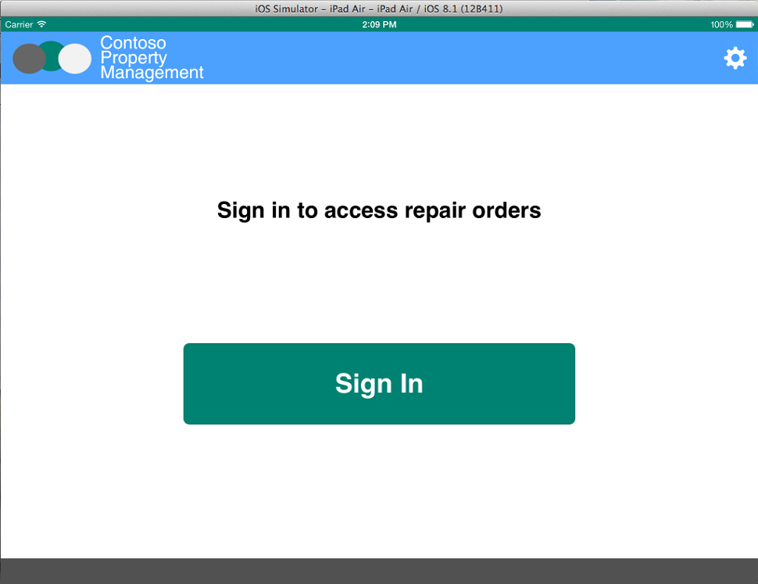
Click Sign In

Slide 55
Enter Repair Person credentials Username: rong@<tenancy>.onmicrosoft.com Password: TempP@ssw0rd! Do not check Keep Me Signed In Click Sign In If you have not already signed in with this user you will be prompted to reset the user’s password.

Slide 56
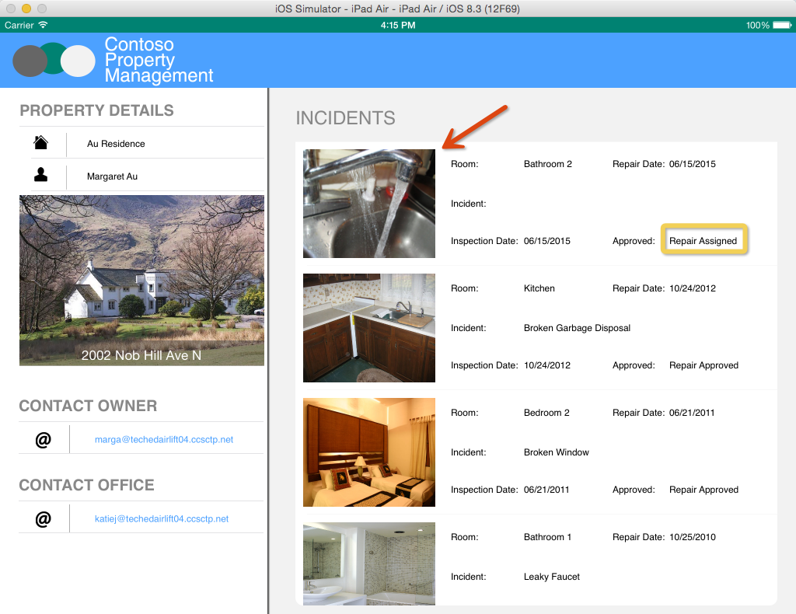
Click the incident assigned by the dispatcher
Another way to open the Repair app and immediately drill down to a given incident is to use the deep link in the email sent to the repair person.
To do this, open Safari on your iOS Simulator or your iPad where the app is installed.
Enter repairapp://<Incident ID> in the URL textbox and press enter, where <Incident ID> is equal to the Incident ID in the email.
In the example email on slide 48 you see the Incident ID is 19. To open the repair app directly to Incident 19 you would enter repairapp://19 in Safari on your iOS Simulator or iPad.

Slide 57
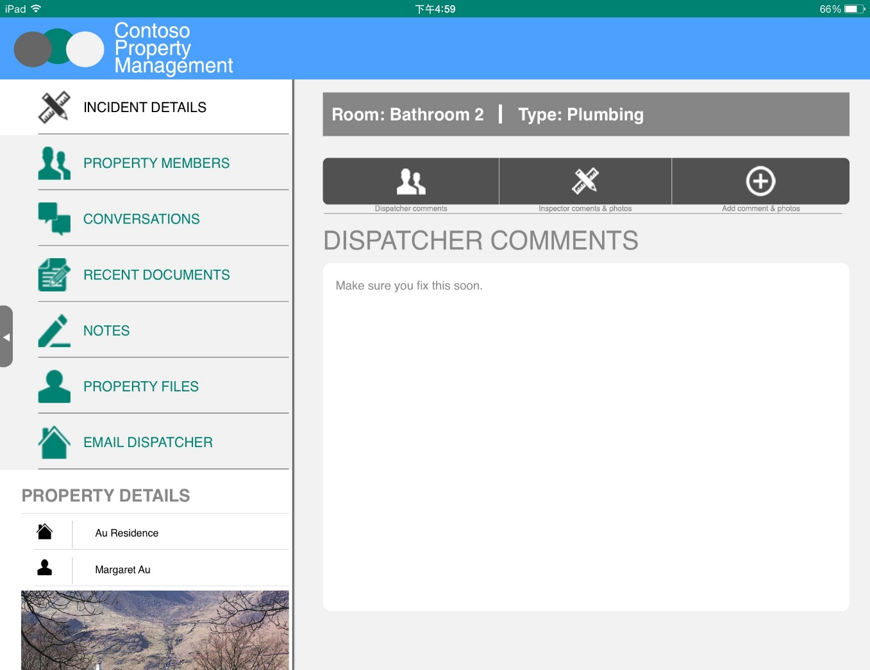
Review the dispatcher’s comments

Slide 58

Click Inspector comments and photos

Slide 59
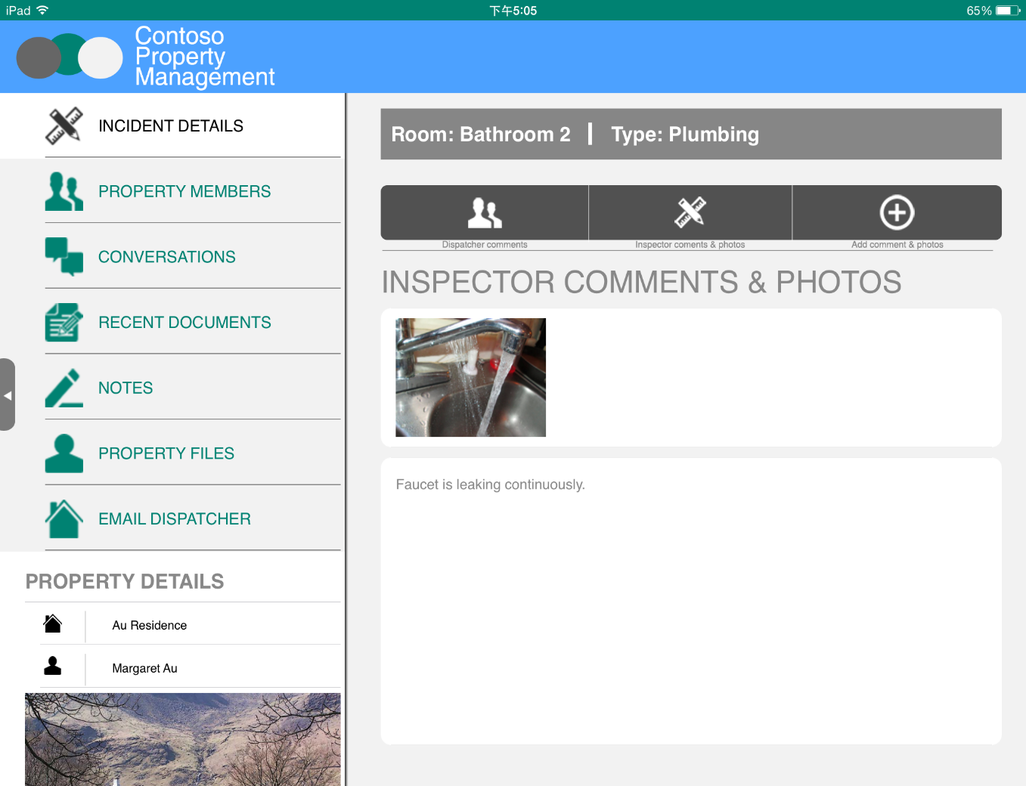
Review inspector comments

Slide 60

Click photo

Slide 61
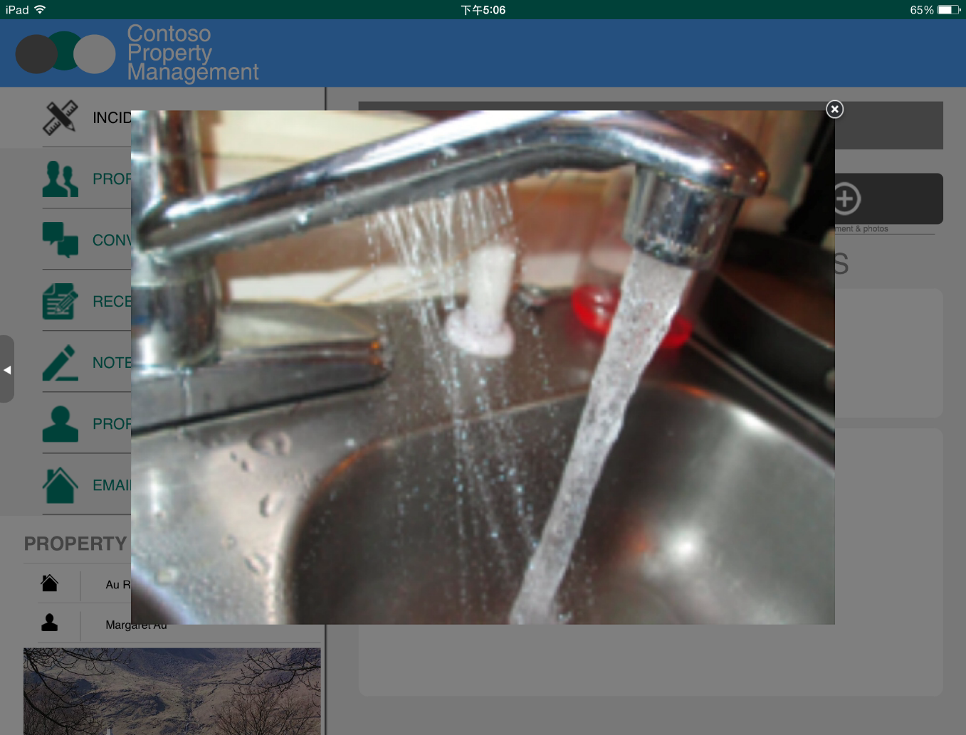
View photo full size, Click the X to close

Slide 62
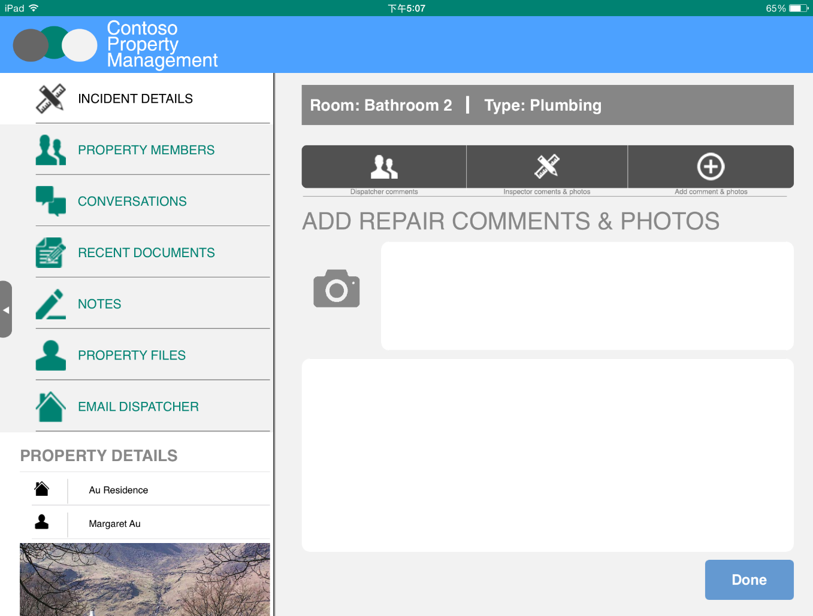
Just like you did in the Inspection App, take a picture and enter comments. Then, tap Done.

Slide 63
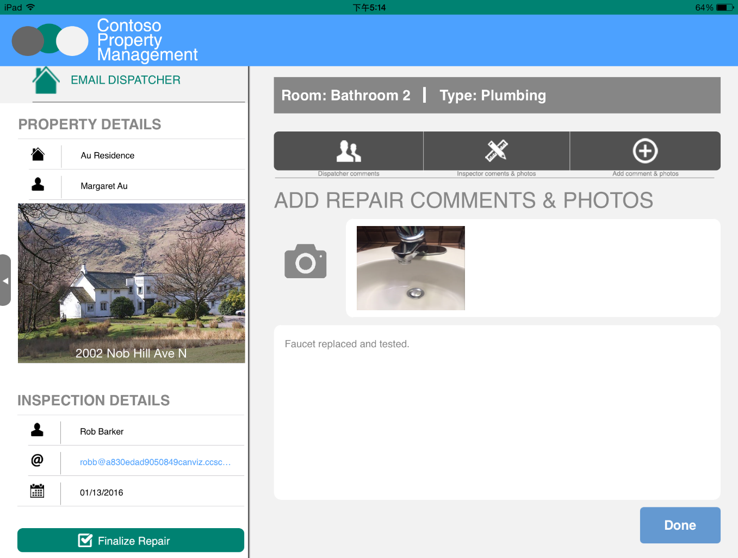
Click Finalize Repair
Incident List is updated with Repair comments, Status, and Repair Completed date
Photo is added to Repair Photos Library
Workflow Task for Repair Person is completed
Workflow Task for Dispatcher is created
The three tasks in the bucket associated with the incident are marked complete.

Slide 64
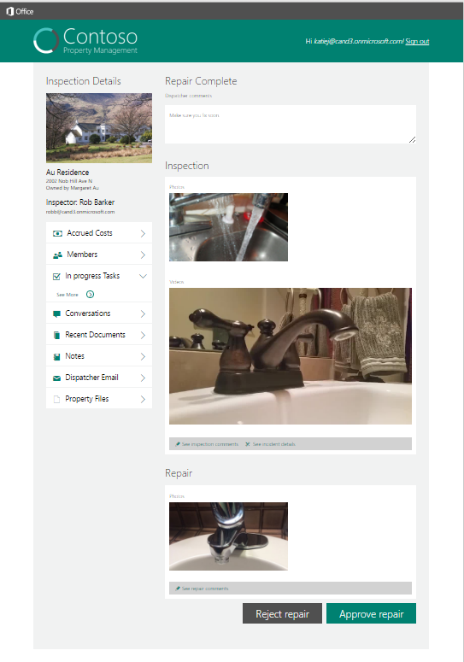
Click the See more link at the bottom of the list and a new browser window opens to view the plan and tasks.
Tasks

Slide 65
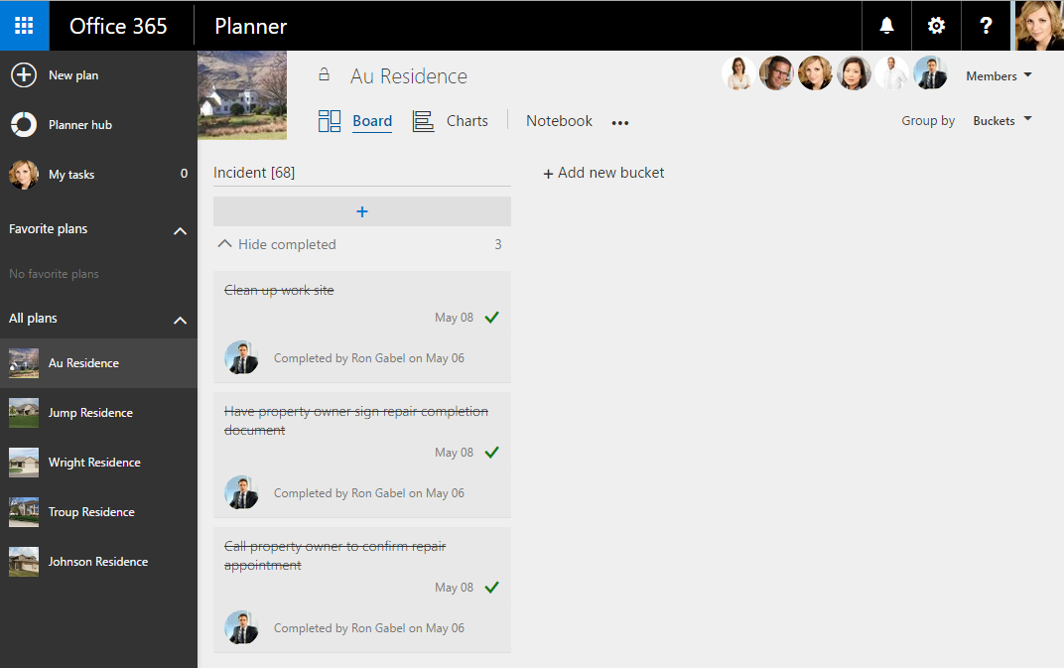
View the plan for the Office 365 Group associated with the property in a new web browser, all tasks associated with this incident are completed.

Slide 66
Approve Repair Walkthrough
The dispatcher reviews the completed repair and approves it.

Slide 67

Email is sent to Property Owner and Dispatcher to tell them the repair is complete. Log in with dispatcher to view email. Username: katiej@<tenancy>.onmicrosoft.com Password: TempP@ssw0rd!

Slide 68

Email is sent to Dispatcher to approve repair. Log in with dispatcher to view email. Username: katiej@<tenancy>.onmicrosoft.com Password: TempP@ssw0rd!

Slide 69

Refresh the Property Management Web App and click Repair complete

Slide 70
Click Not Approved

Slide 71

Review the repair person’s comments and photo and click Approve Repair
Workflow Task for dispatcher is completed
Incident is updated with Repair Approved Status and Date
Workflow History is updated to close workflow

Slide 72

Refresh the Property Management Web App and click Repair complete to see the Approved status.

Slide 73
Webhook Notifications
Popup messages are displayed throughout the demo whenever an email is sent to the dispatcher account (katiej@<TENANCY>.onmicrosoft.com).
The preceeding slides in the deck describe when emails are sent to the dispatcher.
This section describes the notification functionality.

Slide 74

Webhook Subscription
The page load event in the Incident Details page (pictured here) checks to see if a subscription exists in the session. You do not have to do anything except go about using the demo normally and the subscription is created for your automatically when this page loads. When the Incident Details page loads... - if the subscription does not exist, the code creates it and stores it in the session. - if the subscription exists, but it has expired, then the code deletes it and recreates it and stores it in the session. - if the subscription exists and it has not expire then the code does nothing.
- Each subscription's ExpirationDateTime is set to 2 hours from the time it is created.

Slide 75

Popup Messages when Webhook Notifications are Received
To test the notifications, after the subscription is created, send an email to Katie Jordan.
The message will popup on your site. The message subject and sender name is displayed.
If you click X, the popup message is removed.
If you click the message box popup, a new browser tab to will open and display Katie Jordan’s Inbox.

Slide 76


Listener Notifications
To see the raw data associated with the notifications, go to the https://<YourPropertyManagerMyAppSiteURL>/WebHooks/notification page. (You should use your Property Manager My App URL instead of the placeholder <YourPropertyManagerMyAppSiteURL>)
Send some emails to Katie Jordan.

Slide 77
Delete a Subscription
To delete a subscription, follow these steps: 1. In a web browser go to https://YourPropertyManagerMyAppSiteURL/WebHooks/notification. 3. Click the **Delete subscription** button. This will delete the subscription and unsubscribe the notification.

